Slide 1
Poetic Inquiry
Dr Charlotte Wetton
Full resource and worksheet, see:
https://www.ncrm.ac.uk/resources/online/all/?id=20857
Notes:
Slide 1
Hello, I’m Dr Charlotte Wetton and in this video I’ll be going into more detail about how you can use poetic inquiry methodology in your research project.
I’ll talk through 4 quite different examples of published research, concentrating on exactly how the researcher used this methodology.

Slide 2

Using found poetry to illuminate the existential and post-traumatic psychological growth of women with breast cancer engaging in art therapy
Rosemary C. Reilly, Virginia Lee, Kate Laux & Andréanne Robitaille. Qualitative Research in Psychology, 2018
Notes:
Slide 2
First up, I’d like to talk about Reilly et al.
This multi-disciplinary, group-research project was on breast-cancer patients’ psychological trajectory.

Slide 3
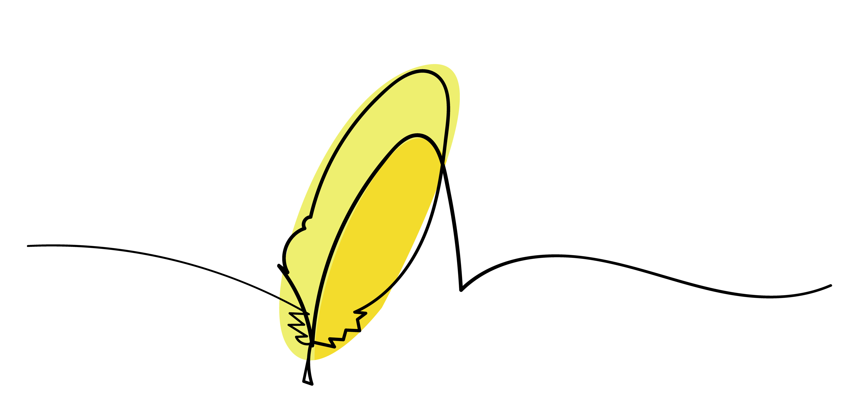
Transcript poems or interview poems: poems written using words from an interview transcript.
Notes:
Slide 3
It’s a great example of using transcript poems in a research project. This is probably the most common way poetic inquiry is done.

Slide 4

The psychological existential growth and post-traumatic growth of breast cancer patients
Ten patients
Montreal, Canada
Multi-disciplinary team
2018.
Notes:
Slide 4
A couple of quick details about the study.
The study examined how participation in art-therapy affected the psychological growth of women who had been treated for breast cancer. The researchers were examining existential growth and post-traumatic growth in the patients.
The study was published in 2018 in Canada.

Slide 5

Use poems as research output
Use poems to disseminate further
‘Creating found poetry is not a linear process’.
Interviewed
Transcribed
Plus artists’ statements
Open and axial coding
One researcher read and re-read
Highlight nuggets (Butler-Kisber)
Different document
Used poetic techniques to re-make
Minimal changes
Reading out loud
Participant-checking / member-checking
Analyse both poems and coding
Notes:
Slide 5
So how did the researchers go about their method?
Each patient was interviewed, using semi-structured interviews with an open-ended, conversational format. And the interviews were transcribed. Plus, the researchers used the artists statements which five of the participants had written for an exhibition. The researchers coded the interview transcripts, using open and axial coding. Note that not all poetic inquiry projects use coding.
The researchers say in the article ‘Creating found poetry is not a linear process’.
One of the researchers read and re-read the transcripts many times to understand the subtleties of the participants’ words – a core strength of poetic inquiry.
She then highlighted ‘nuggets’ as Butler-Kisber called them; that is words, phrases or sentences which were particularly meaningful, powerful or thought-provoking.
Then she transferred these ‘nuggets’ to a different document and used poetic techniques such as stanza break, line length, enjambment etc to recreate them as poems.
She conserved virtually the same order, syntax and meaning as the original transcripts with minimal alterations or additions. Changes were made for grammatical sense and to increase lyricism.
Reading the poems out loud throughout this process was important.
The poems were then shared with the research participants for participant-checking (or member-checking) and they confirmed the resonance of the poems.
The researchers were then able to use both the poems and the more traditional thematic coding to identify seven key findings about the effect of the art-therapy.
The researchers wrote these findings in an academic article including the seven poems as part of their findings. So the poems are the method of analysis and the research output.
The researchers also commented on using their poetic inquiry study to communicate more widely with health professionals. And on the usefulness of poetic inquiry in increasing health professionals’ understanding of the patient experience.

Slide 6
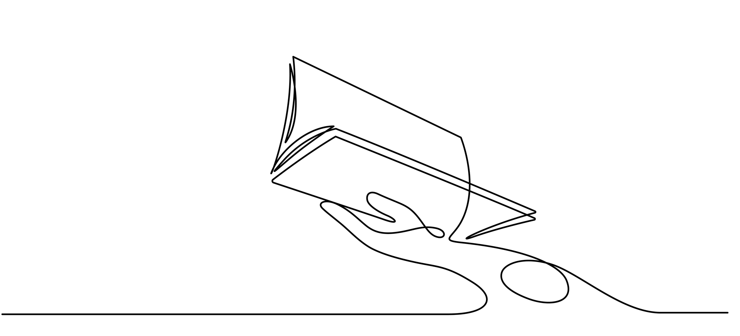
IRB as Poetic Inquiry
Maria K. E. Lahman, Eric D. Teman, and Veronica M. Richard.
Qualitative Inquiry Vol 25.2. 2019.
Notes:
Slide 6
In this next example, I’ll look more at the reflexivity of the researcher and the auto-ethnographic approach. This study is by Lahman et al from the United States, in 2019.
This project does not involve using participants words at all. The researchers are employing a poetic inquiry methodology to interrogate their own research context and practice.

Slide 7

Autoethnographic poems:
poems written from a researcher’s own experience.
Notes:
Slide 7
The three authors of this study all conduct research with groups who are designated as vulnerable; and in this project, they wrote poems about their own experience of conducting research with vulnerable groups and their IRBs — that’s the Institutional Review Board, the equivalent of an ethics committee. So this is the auto-ethnographic poetic inquiry method.

Slide 8

Found poems:
writing poetry using words from an existing source text.
Notes:
Slide 8
The researchers also used found poetry: writing poetry using words from an existing source text, in this case from an academic article on IRBs. And the researchers employed various poetic techniques when writing found poetry. One of the poems uses the poetic technique of erasure poetry, in which words are marked-out of an existing text, leaving only key words selected by the researcher-poet.

Slide 9
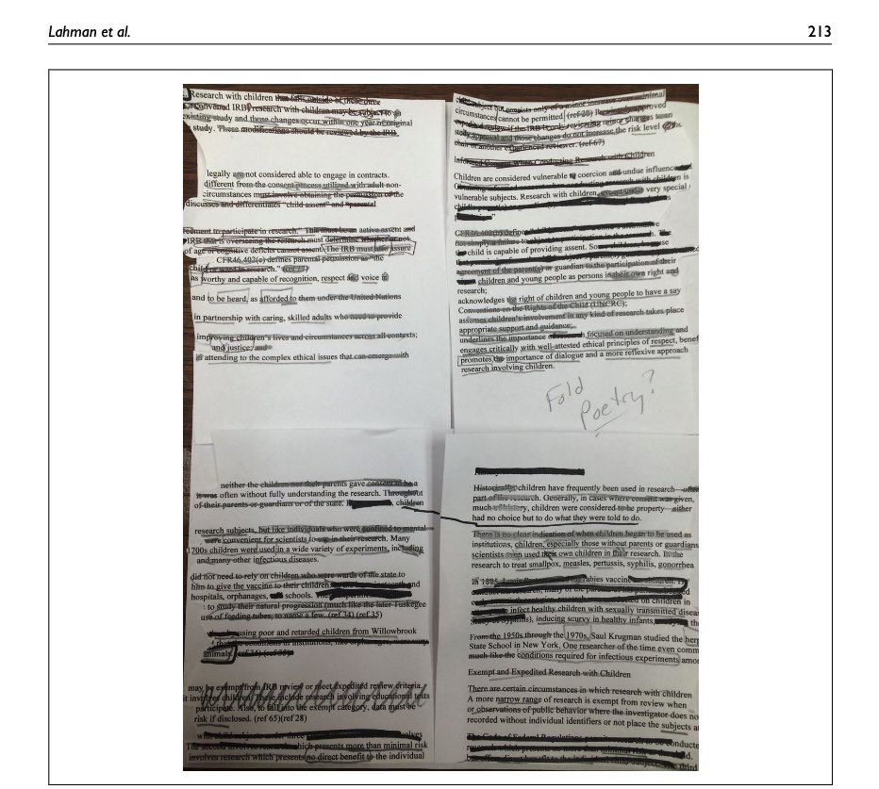
Cut-up Poetry:
Cutting the text into quarters.
Labeling the section number 1 to 4 starting at the top left and moving right, then down
Switching section 1 with 4, and 2 with 3
Reading across the sections as one would normally read prose while eliminating words that do not feel salient
At this point, some poets move words or change features such as punctuation
Notes:
Slide 9
Another uses the technique of cut-up poetry in which a chosen text is manipulated — here the US guidelines for research with children. This cut-up technique deliberately defamiliarizes the text. In the article, the process is described as:
Cutting the text into quarters
Labeling the section number 1 to 4 starting at the top left and moving right, then down again
Switching section 1 with 4, and 2 with 3
Reading across the sections as one would normally read prose while eliminating words that do not feel salient.
At this point, some poets may move words or change features such as punctuation
The researchers also used visuals and collage in this project.

Slide 10
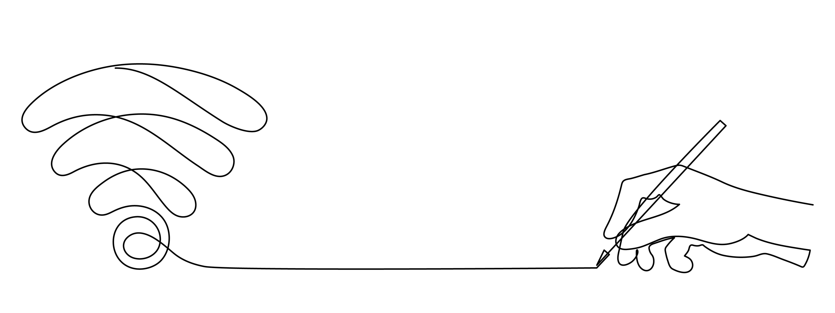
Used poetic inquiry methodology to ‘interrupt the scholarly text and allow new ways of considering old issues’
Notes:
Slide 10
They used poetic inquiry methodology to ‘interrupt the scholarly text and allow new ways of considering old issues’.
The researchers used poetic inquiry methodology to disseminate their research findings. These poems form the bulk of their academic article and they also presented them in a conference poster.

Slide 11

Real Women Run: Running as Feminist Embodiment
Sandra Faulkner.
Routledge. 2018.
Notes:
Slide 11
You can use both transcript poetry and auto-ethnographic poetry in the same project. The next piece of research I want to talk about is Sandra Faulkner’s book ‘Real Women Run: Running as Feminist Embodiment’, investigating how and why women run. It’s relevant to know that Faulkner is herself a woman-runner. The book was published in 2018 in the United States.

Slide 12

A poetic inquiry of 41 interviews with women runners
A hybrid memoir (prose & poetry)
  autoethnography
  participant-observer ethnography
  field note poems
A critical content analysis of online materials aimed at women runners
Notes:
Slide 12
Faulkner’s book is a series of linked ethnographies, using different methods. The book includes, firstly, a poetic inquiry of 41 interviews with women runners; secondly, a hybrid memoir (that is, prose and poetry) which uses both auto-ethnography and participant-observer ethnography, including poems written from field notes; and thirdly, a critical content analysis of online materials aimed at women runners.

Slide 13

Transcript poems/interview poems:
‘I took women’s exact words and language from the interviews and arranged them in lines that mirrored speaking styles and breath, arranging their words to resemble their performances of the oral.’
Notes:
Slide 13
So what was her process? When creating transcript poems from the interviews with runners, Faulkner writes that: ‘I took women’s exact words and language from the interviews and arranged them in lines that mirrored speaking styles and breath, arranging their words to resemble their performances of the oral.’ As part of her analysis, Faulkner listened to her recorded interviews on her iPod as she ran, so that she was literally running with her participants.
As part of her autoethnography chapter, Faulkner wrote a running-log of her own running in the form of haiku poems, and often composed the haikus while running.

Slide 14
‘In my field notes, I found poems. I wrote many entries in my field notes as poems, and constructed many poems while running.’
Notes:
Slide 14
Another form of poetic inquiry she uses is poems written from field notes. The says: ‘In my field notes, I found poems. I wrote many entries in my field notes as poems, and constructed many poems while running’.

Slide 15
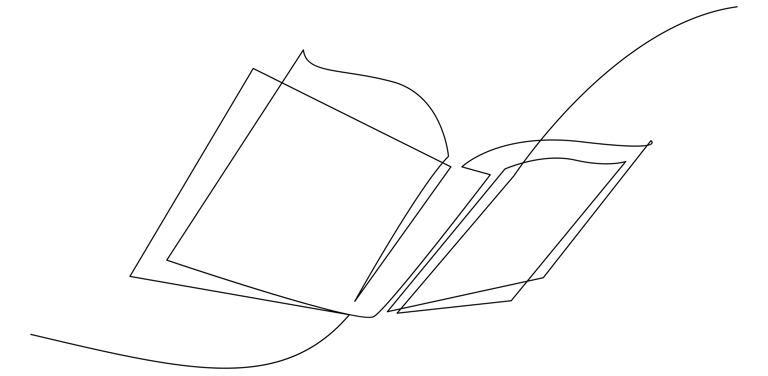
‘Writing reflective poems helps researchers ask more focused questions, and questions that they may not have considered.’
Notes:
Slide 15
Faulkner describes how these different forms of poetic inquiry methodology supported each other. Her autoethnographic poems helped her to analyse other women’s running stories: ‘Writing reflective poems helps researchers ask more focused questions, and questions that they may not have considered’.

Slide 16
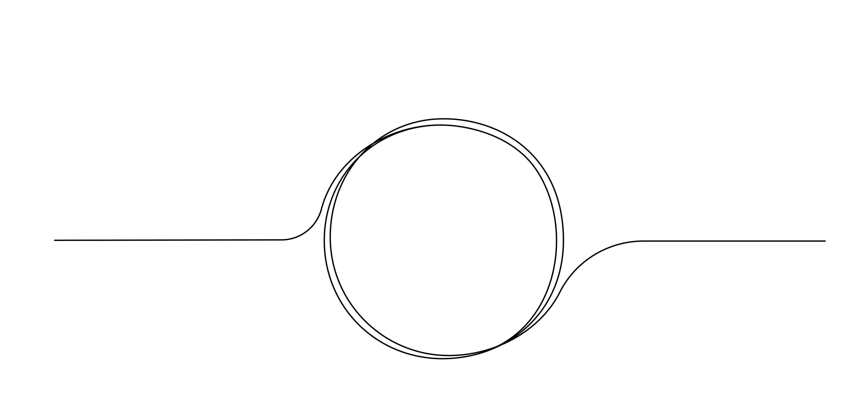
Birthing vital stories: An examination of First Nations Australian maternal care narratives
Alexus Davis. PhD thesis.
University of Manchester. 2025.
Notes:
Slide 16
The last study I want to talk about is a sociology PhD project by Alexus Davis on Australian Aboriginal birth experiences. The thesis was submitted in 2025 at the University of Manchester, UK.
This researcher, who was working during the covid pandemic, analysed podcast episodes in which Aboriginal women told their birthing stories.

Slide 17
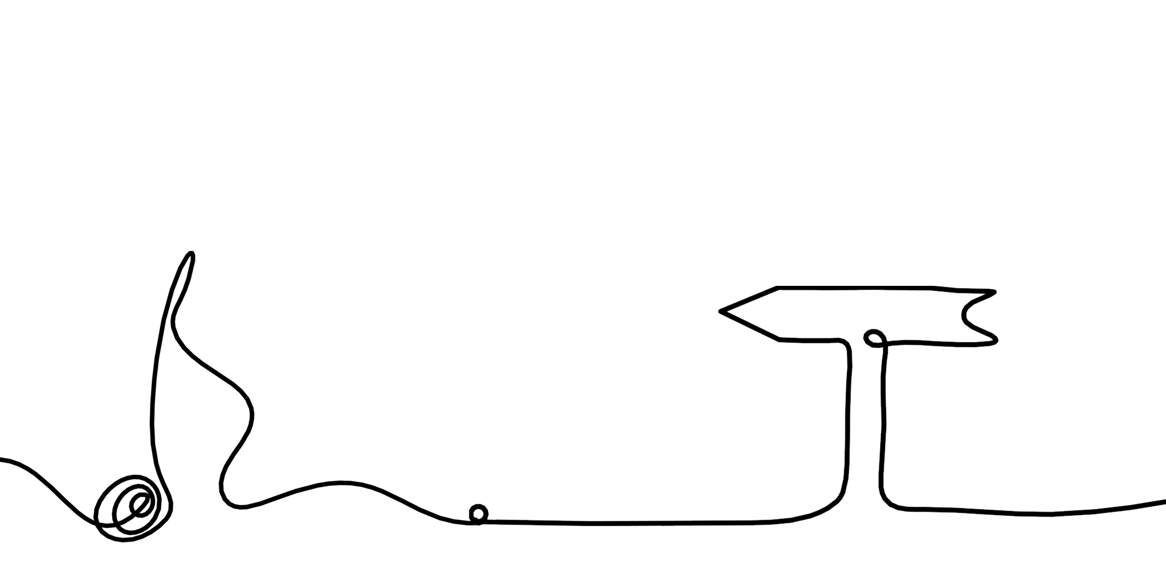
Academic literature poem:
a found poem written from a piece of academic writing.
Notes:
Slide 17
Like Reily et al, Davis also used transcript poems written from research subjects’ words. But here I’ll talk about her academic literature poem.
At the end of the ‘Stories’ Chapter, Davis concludes with a poem. She uses poetic inquiry as part of her research output, as a way to extend and deepen her analysis and to be reflexive.

Slide 18

Read the data (the chapter) while making notes and highlighting
Coded where the chapter responded to the research questions
Personal reflection
Using words from the chapter
Notes:
Slide 18
She describes treating her own academic chapter as if it was a transcript or other raw data and following a similar process. Here is the process she outlines:
She read the data (in this case the chapter) while making notes and highlighting responses, feelings and analyses.
Then she coded instances where the chapter responded to the initial research questions.
She reflected on her own experiences and position as researcher.
She used words from the chapter to write the poem

Slide 19
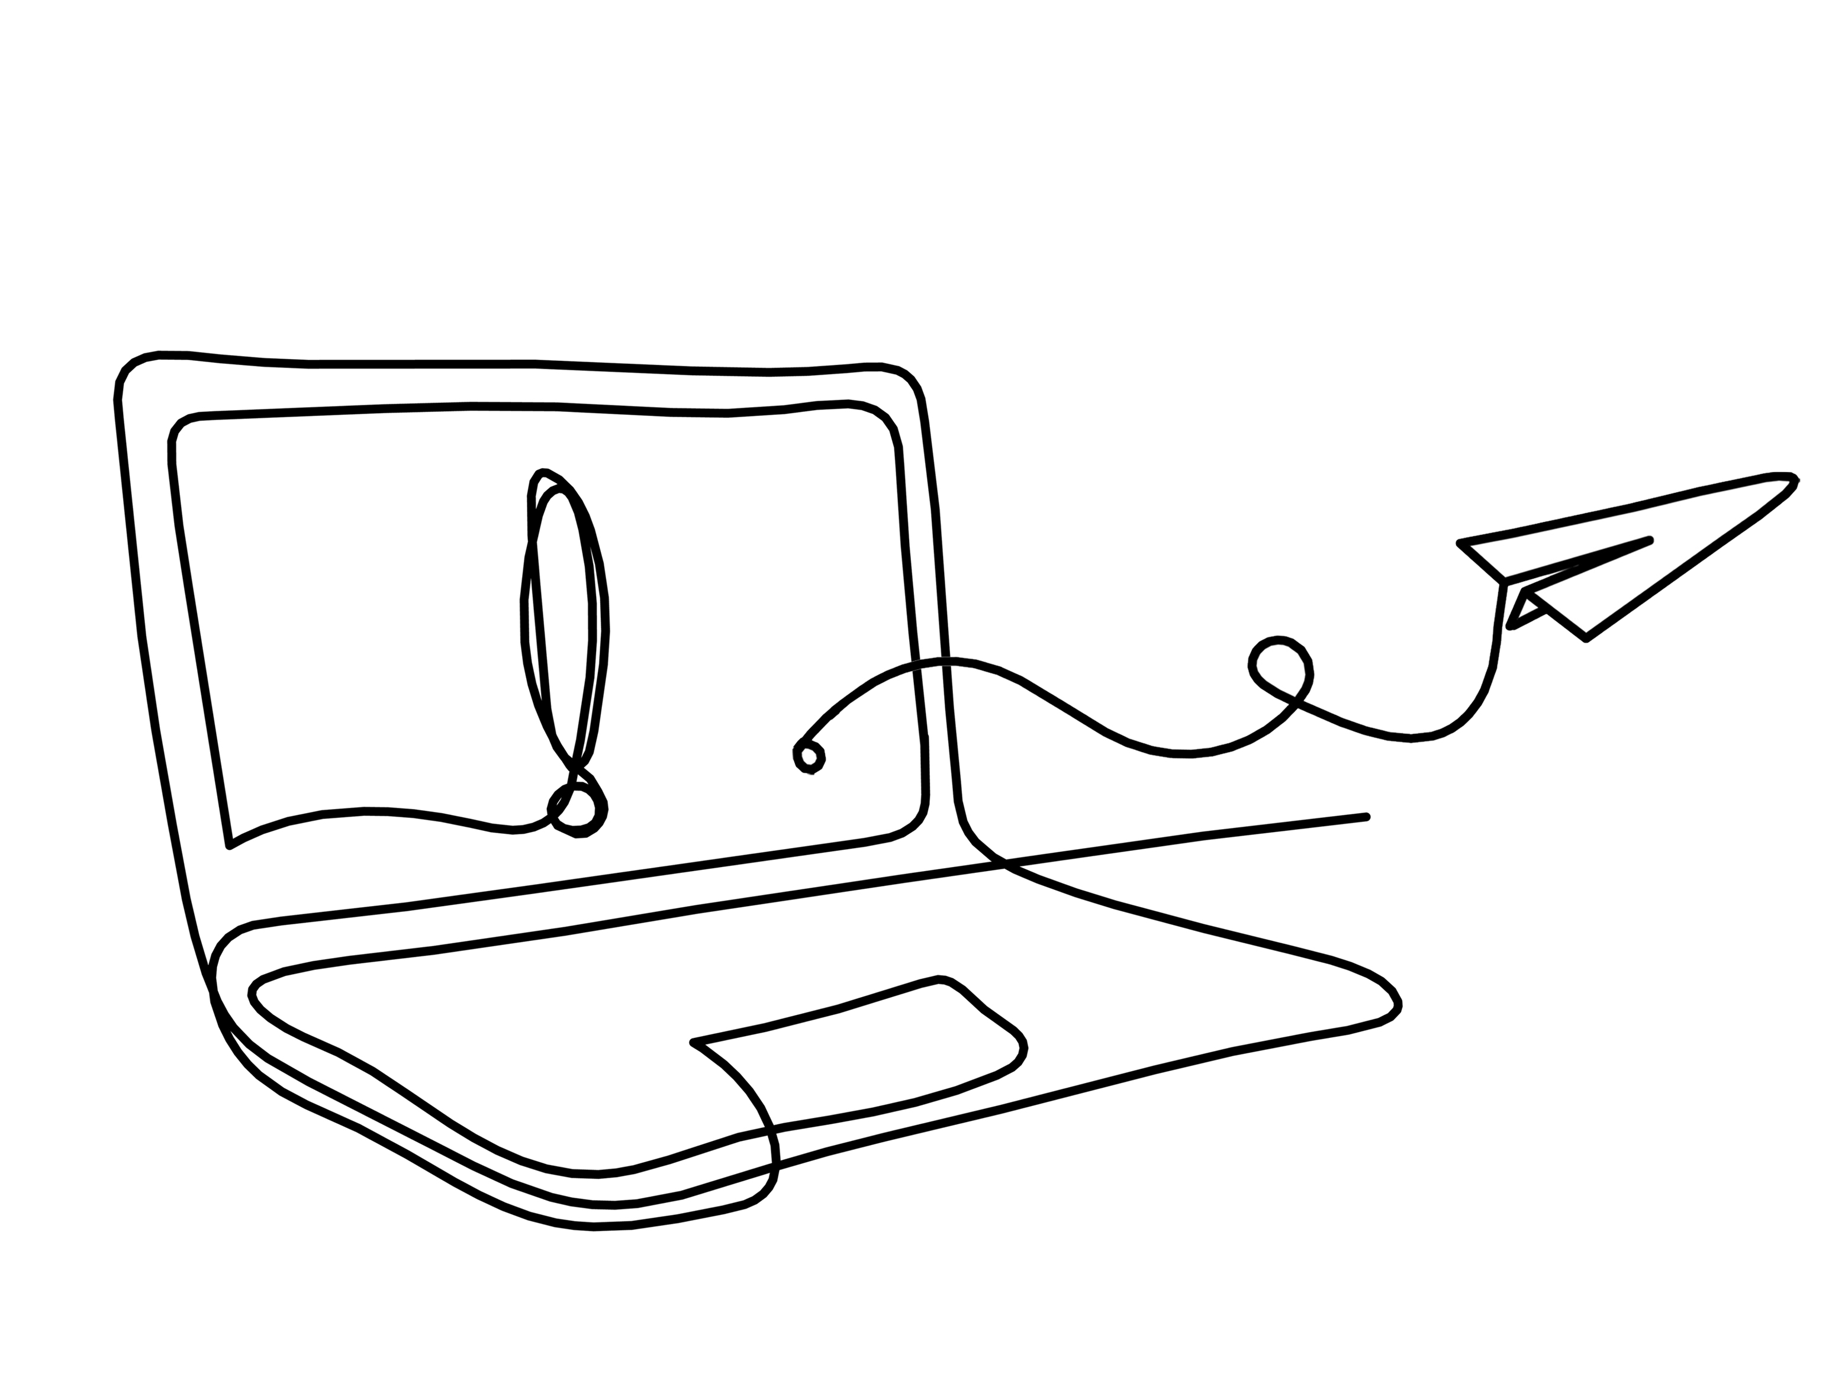
Autoethnographic approach
Writing an academic literature poem
Reflexive
Using secondary reading
Notes:
Slide 19
Here, Davis blends two approaches, taking an autoethnographic approach to poetic inquiry and writing an academic-literature poem, using an academic text (in this case, her own) as source data. This approach allowed Davis to use all of the reading and research that went into her chapter, while also being reflexive and examining her own thoughts and feelings as a researcher.

Slide 20
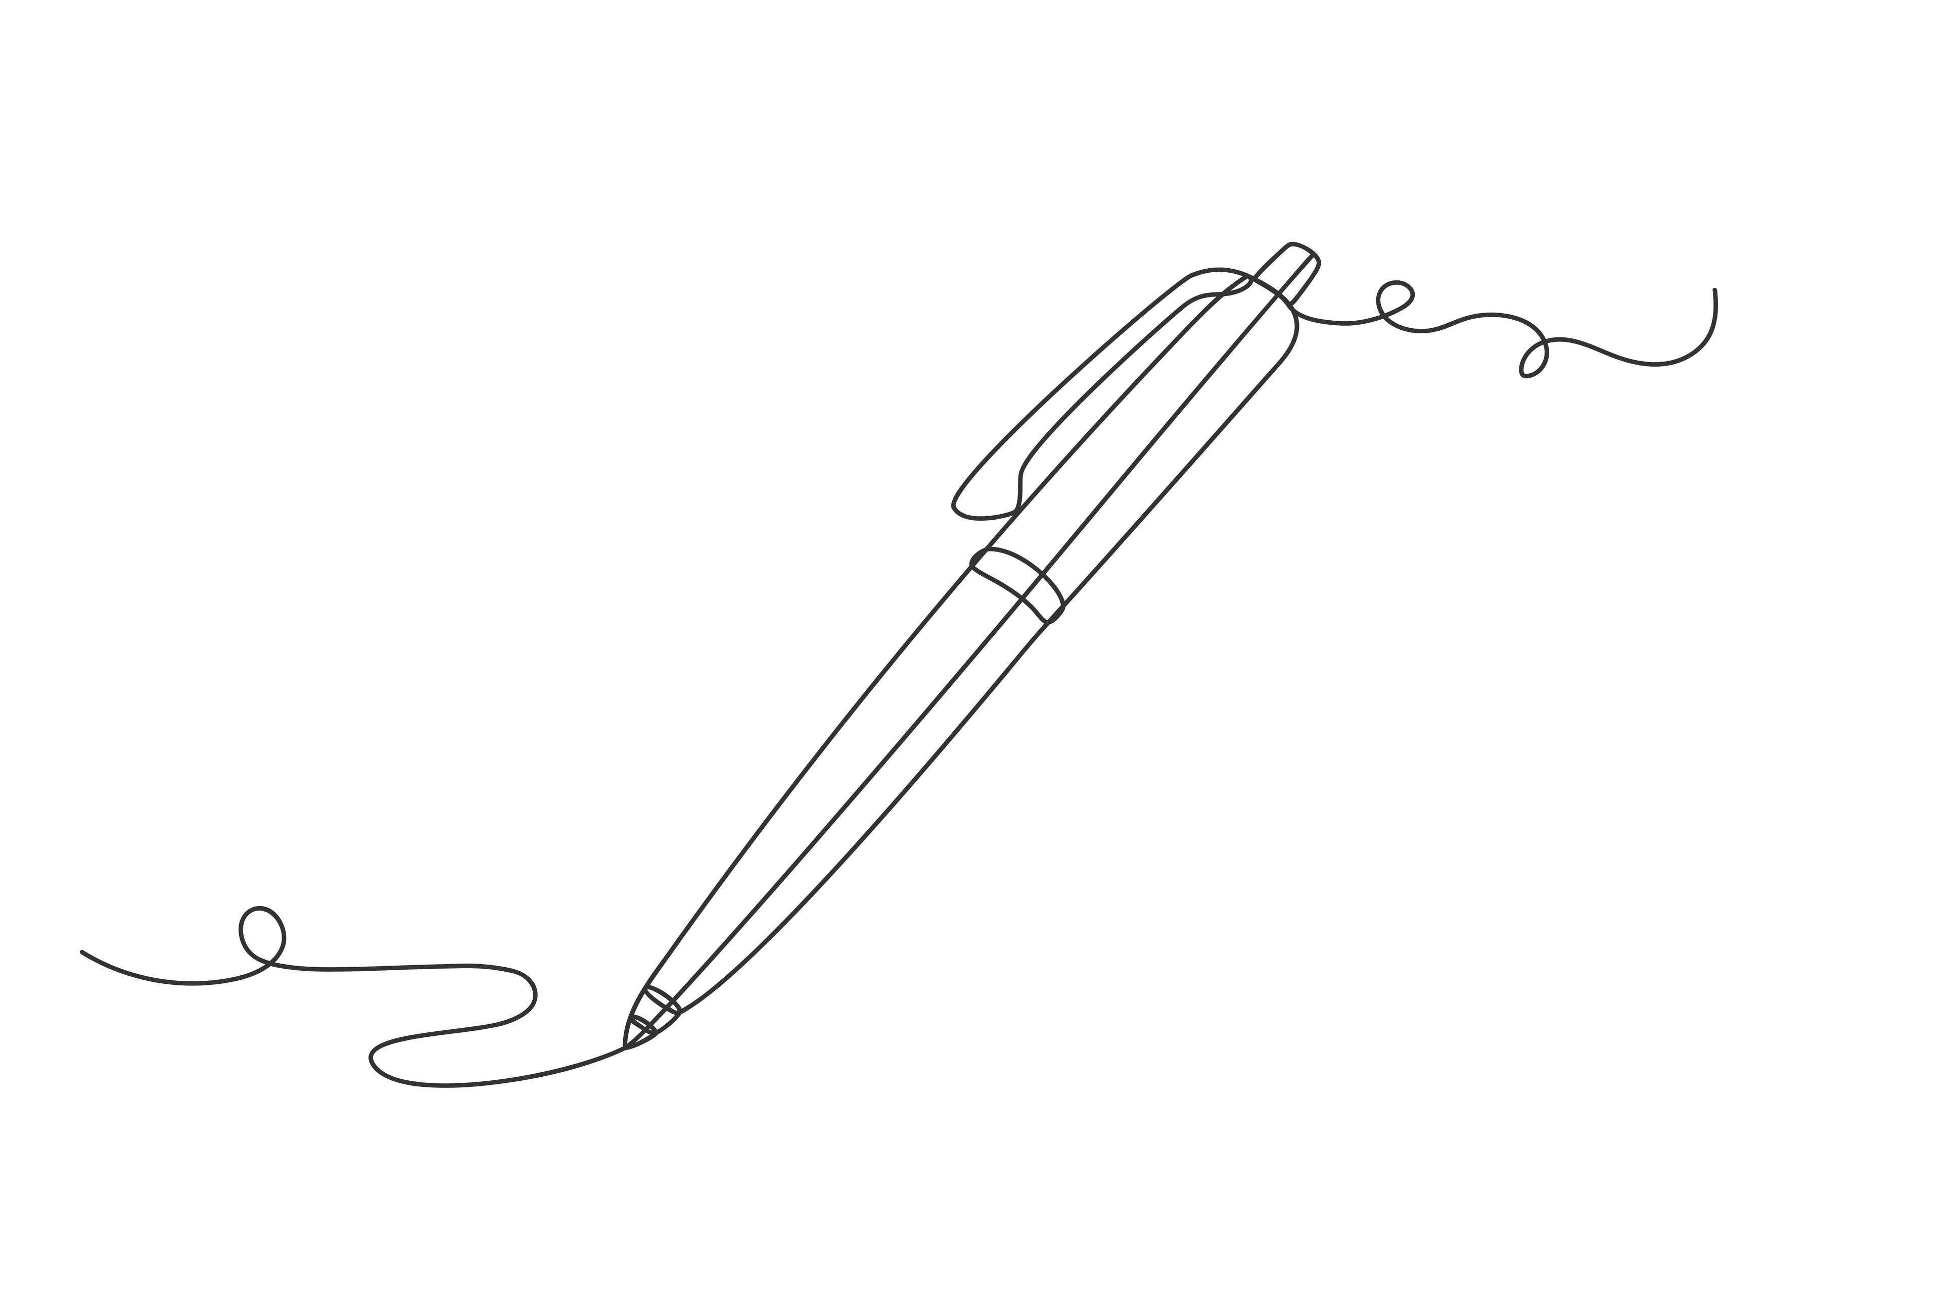
Using found poetry to illuminate the existential and post-traumatic growth of women with breast cancer engaging in art therapy, Rosemary C. Reilly, Virginia Lee, Kate Laux & Andréanne Robitaille, 2018
IRB as Poetic Inquiry, Maria K. E. Lahman, Eric D. Teman, and Veronica M. Richard, 2019
Real Women Run: Running as Feminist Embodiment, Sandra Faulkner, 2018
Birthing vital stories: An examination of Frist Nations Australian maternal care narratives, Alexus Davis, 2024
Notes:
Slide 20
So to summarise, we’ve looked at four different research projects which I’ve chosen to showcase different forms of the poetic inquiry methodology.
We looked at Reilly et al who examined cancer patients’ psychological development following art therapy.
We looked at Lahman et al who wrote about their own research experience with vulnerable participants and Institutional Review Boards.
We looked at Faulkner who wrote a book of ethnographies on women runners.
And we looked at Davies who was researching Australian aboriginal birth stories.
And this showed us a number of different forms of the poetic inquiry methodology. You’ll have seen that there is no one way of doing poetic inquiry or one strict process that must be followed.

Slide 21
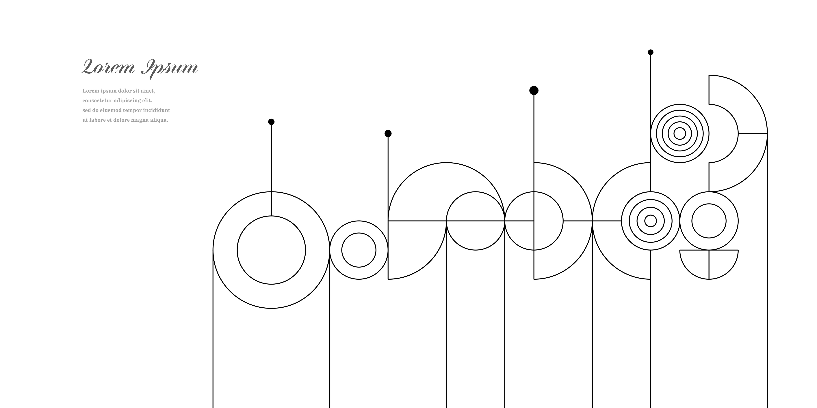
Transcript poems, or interview poems: written from interviews with participants.
Autoethnographic poems: written from a researcher’s own reflexions.
Field note poems or ethnographic poems: field notes written as poems, or poems written up later from field notes.
Found poems: written from a source text.
Academic literature poems: written from academic writing.
Notes:
Slide 21
We’ve seen:
transcript poems, or interview poems; that’s poems written from interviews with participants.
Autoethnographic poems, written from a researcher’s own reflexions
Field note poems or ethnographic poems; that’s field notes written as poems ,or poems written up later from field notes
Found poems, written from a source text, such as official guidelines
Similarly, academic literature poems, written from a source text, here the researcher’s own thesis chapter.
The process of writing the poem (whether from participant interviews, field notes or self-reflection) is a mode of analysis and provides insights; the poems themselves can then be used as a research output in academic publications; and the poems can provide an interesting, accessible way of further disseminating research results, for example, to health professionals.

Slide 22
www.ncrm.ac.uk
Notes:
Slide 22
Check-out the worksheet attached to this resource which will help you to work out whether poetic inquiry is right for your research project.
Thank you for watching and happy writing.

